Slide 1
BAGGIT
SUPRIYA
SONALI
AJAY KUMAR
SWETHA JOSHI

Slide 2
BAGGIT
Baggit is a Commerce Site where we can order products from various categories.
In initial Sprint the categories that are in our site are as follows:
Electronics
Toys
Sports
Furnitures
Beauty
Various Special features have been attributed to them for the ease of the Customer

Slide 3
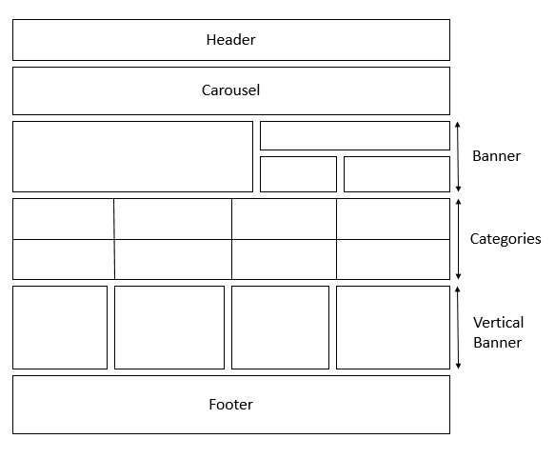
HOME

Slide 4
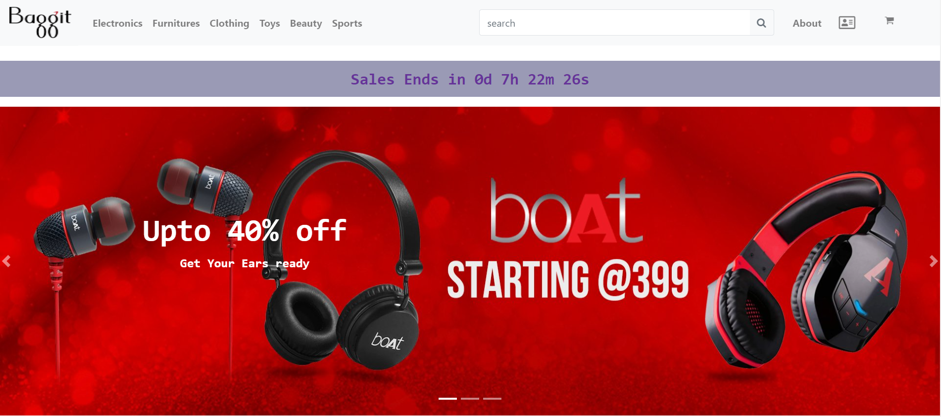

Slide 5


Slide 6


Slide 7


Slide 8
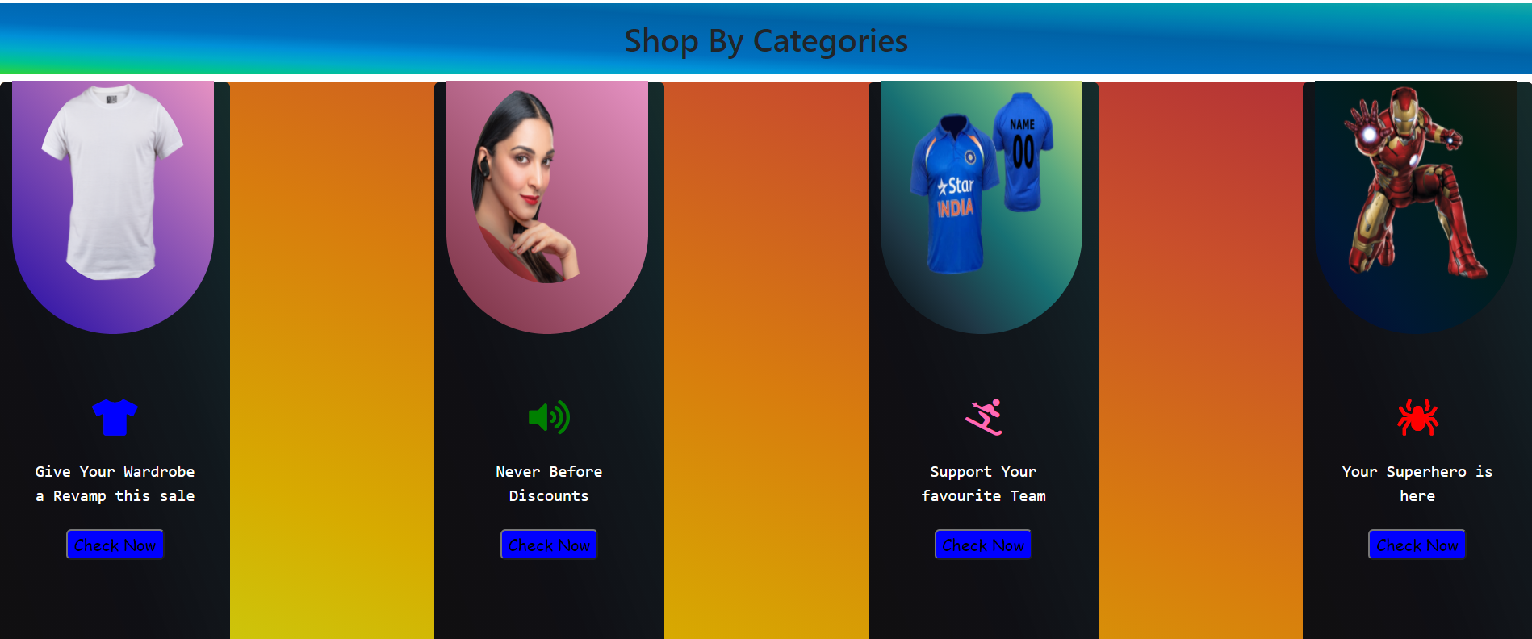

Slide 9
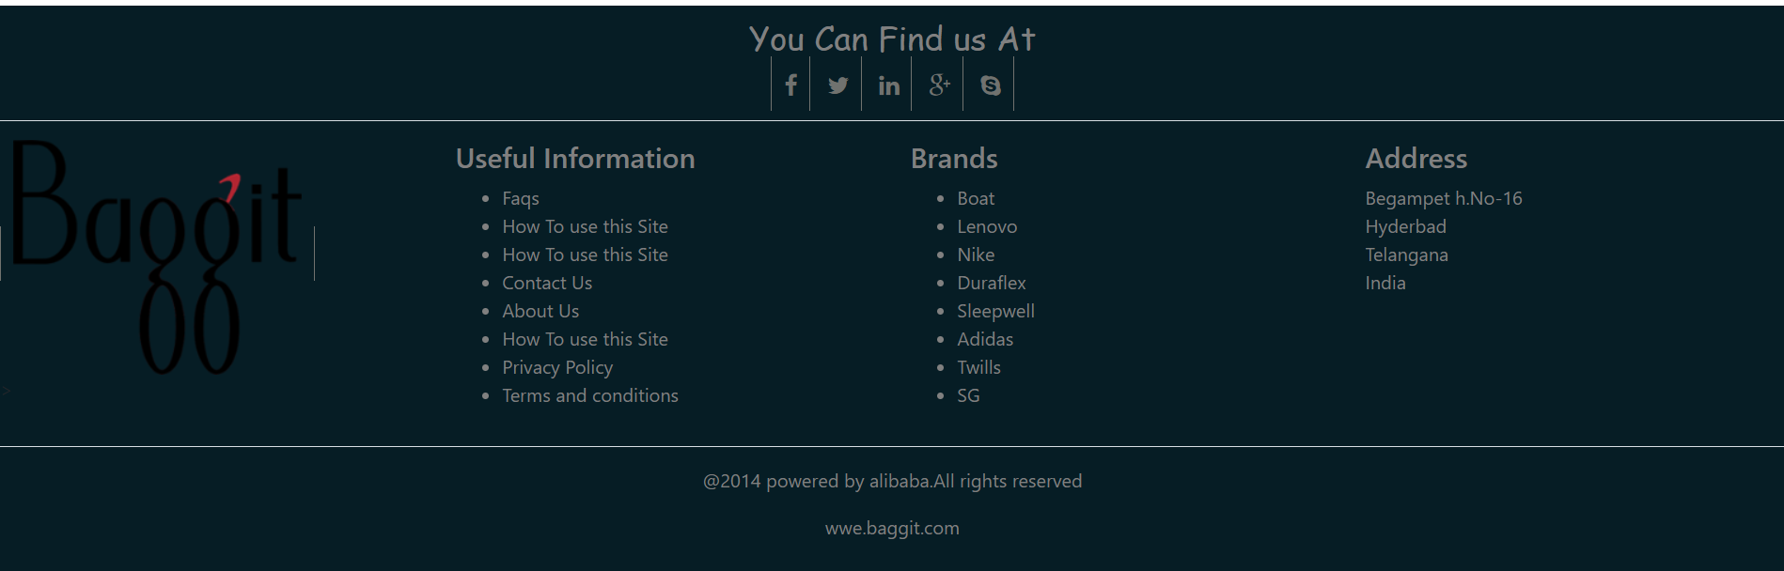

Slide 10
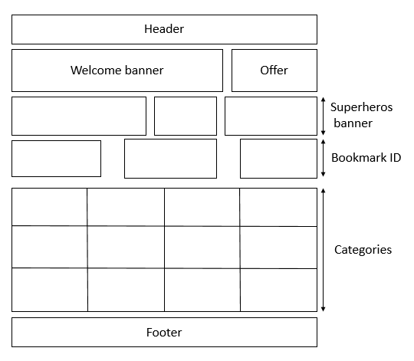
TOYS

Slide 11
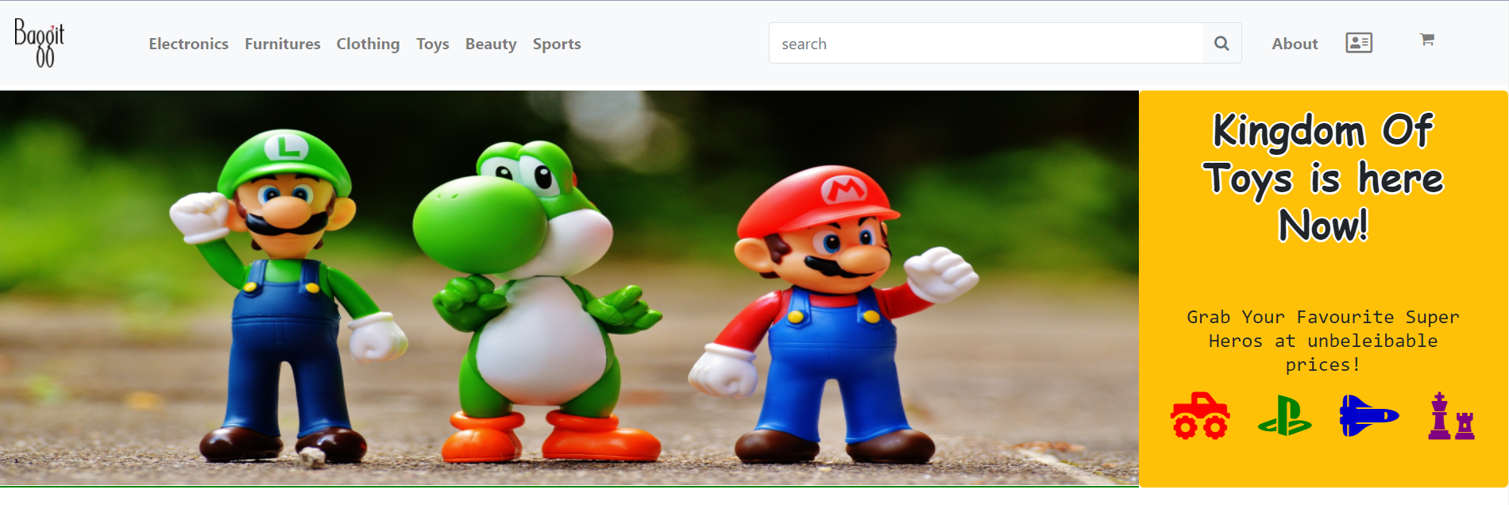

Slide 12
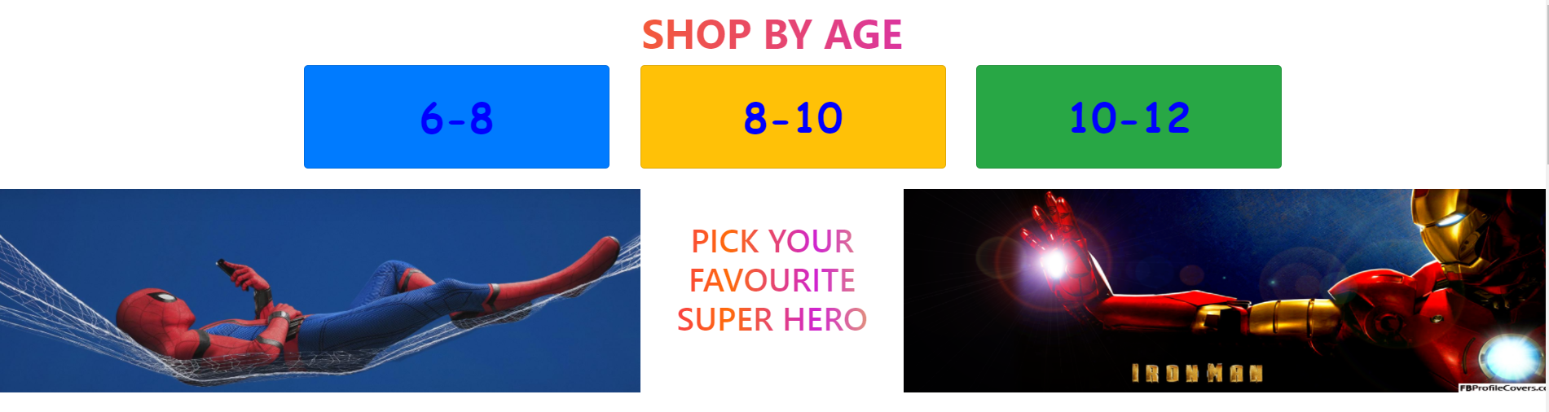

Slide 13
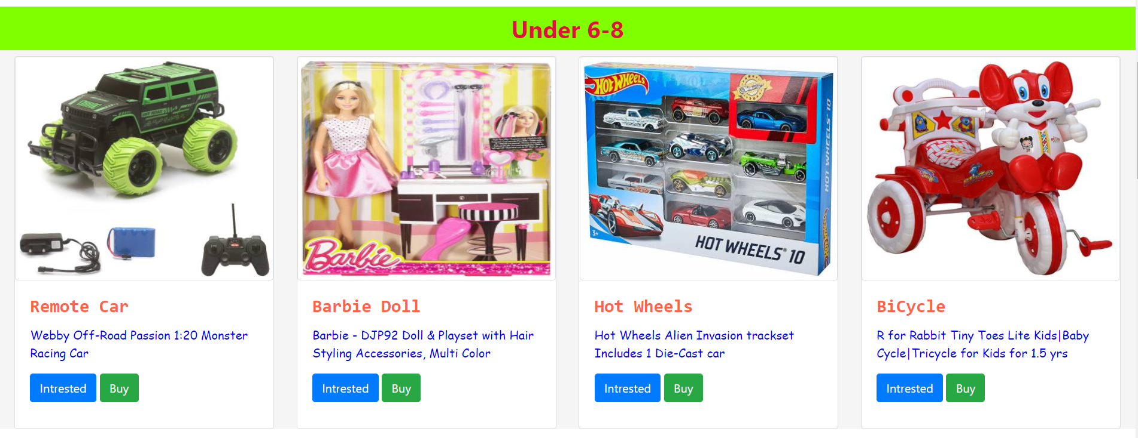

Slide 14
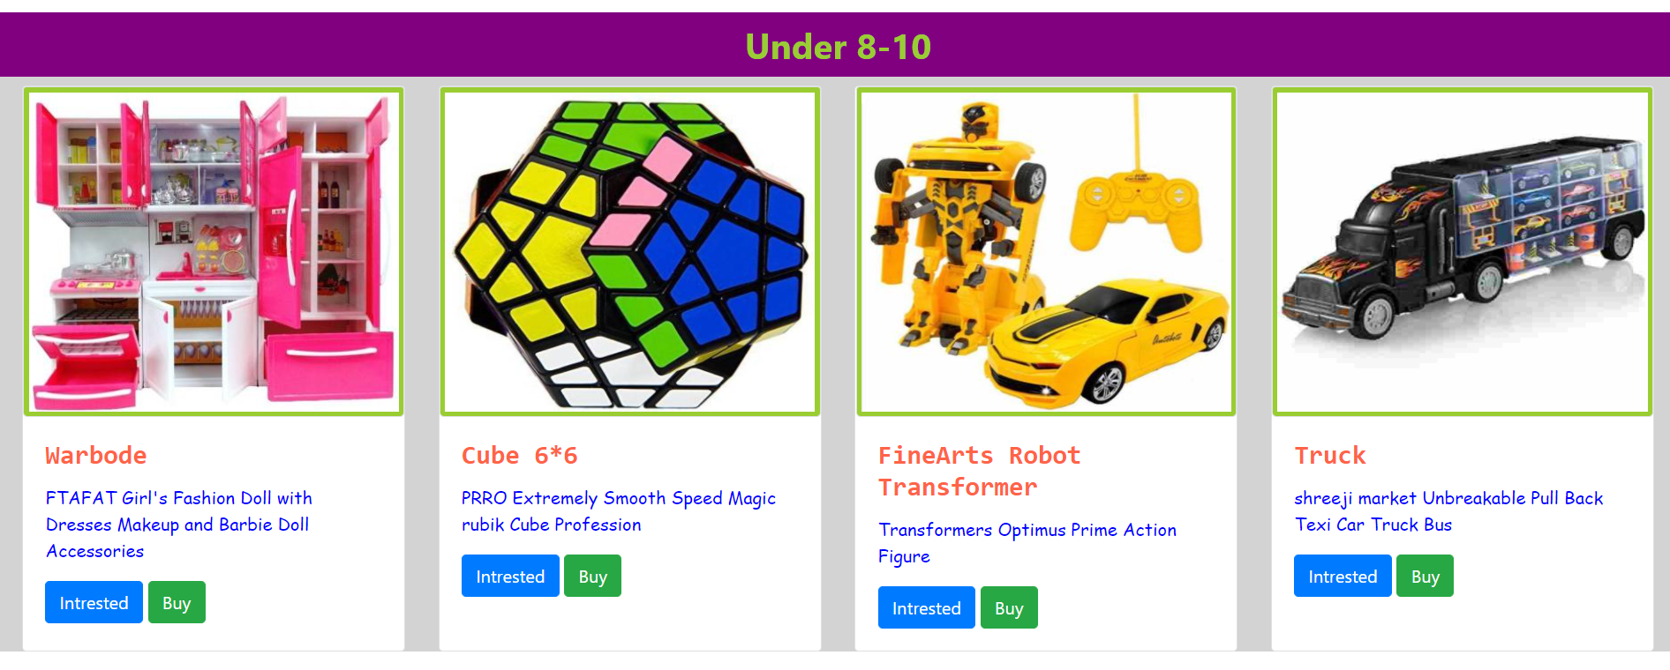

Slide 15
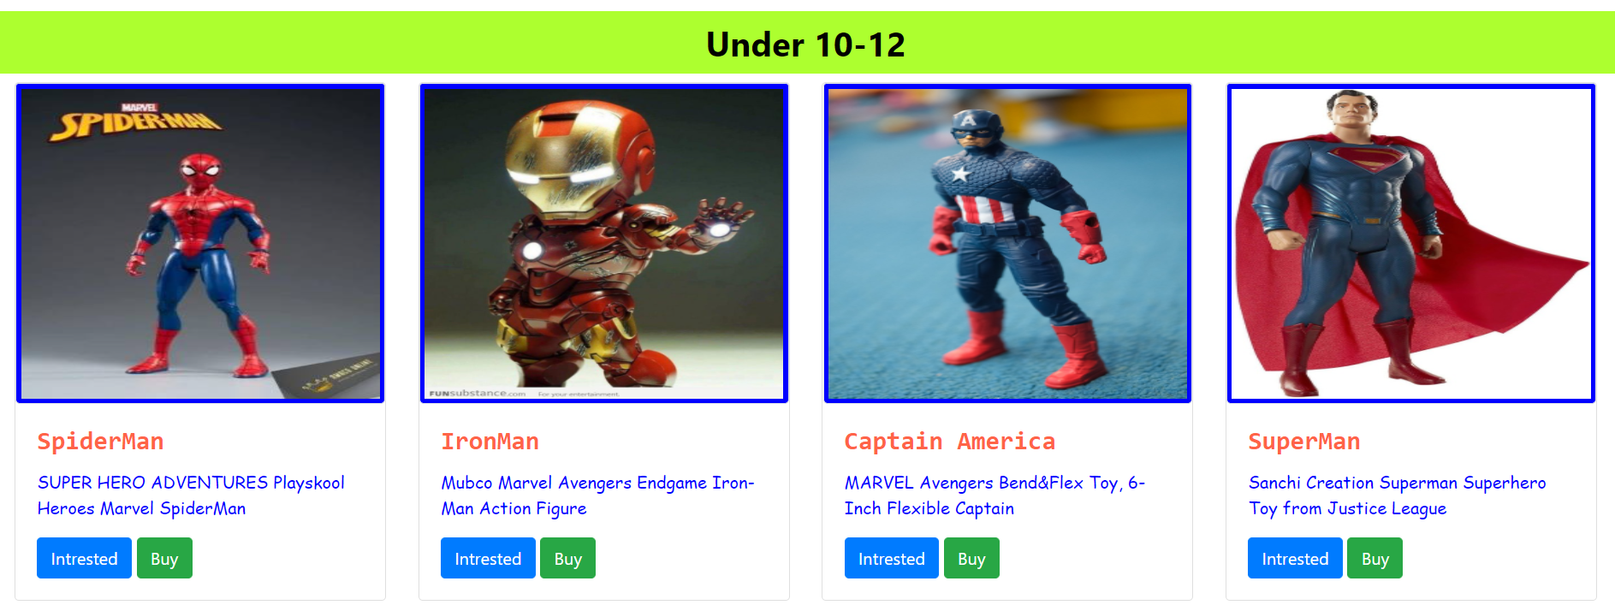

Slide 16
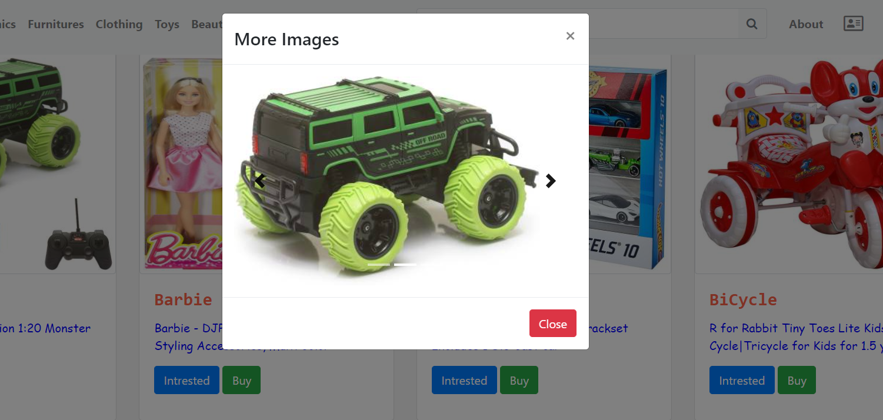

Slide 17
ELECTRONICS

Slide 18
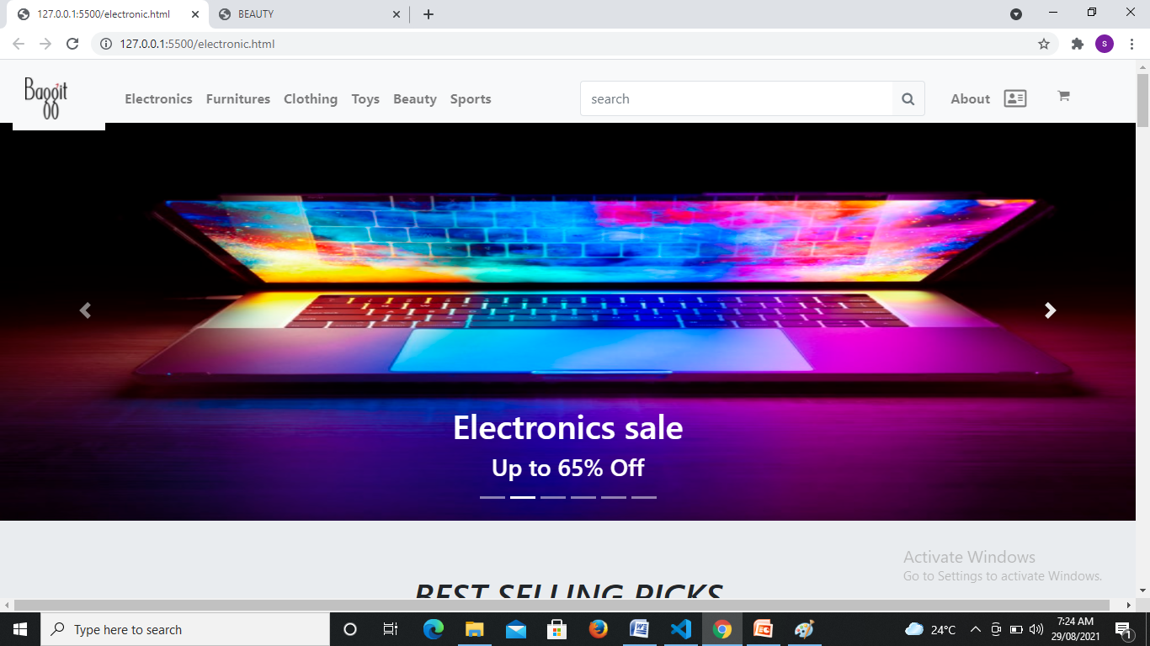

Slide 19
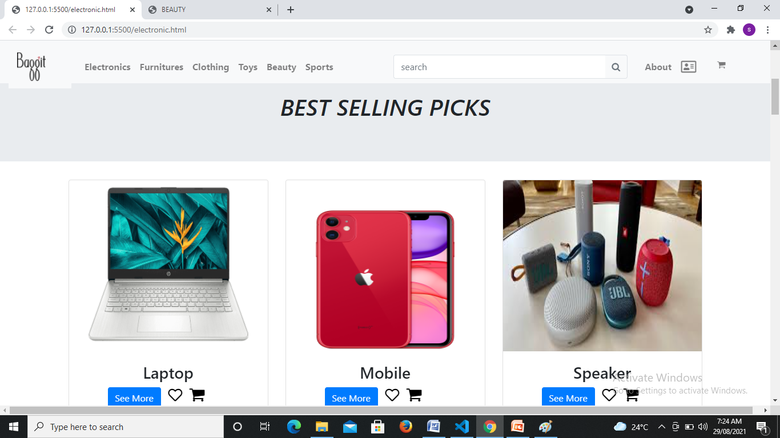

Slide 20
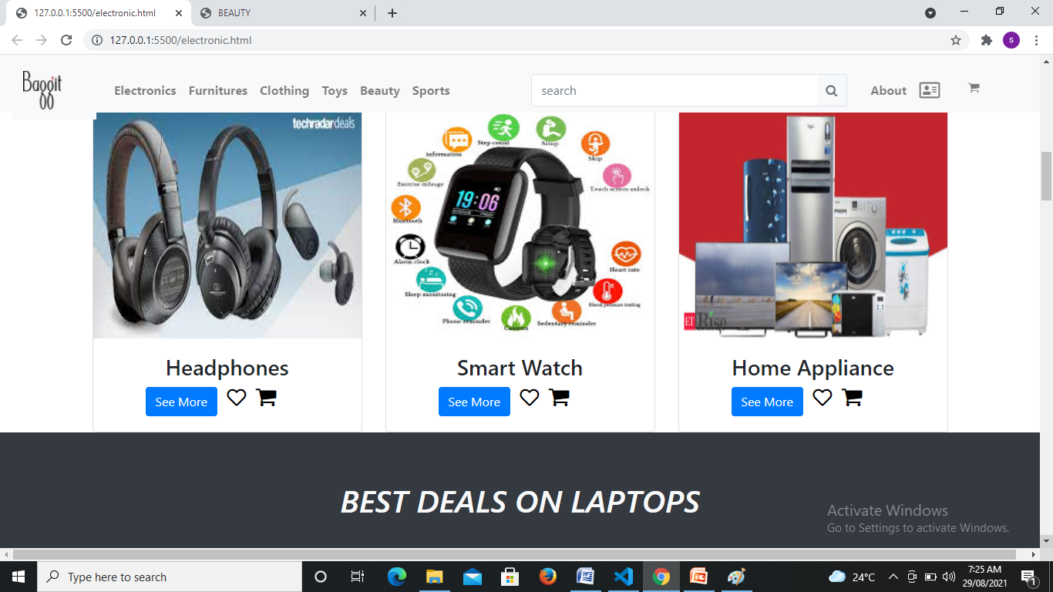

Slide 21
BEAUTY

Slide 22
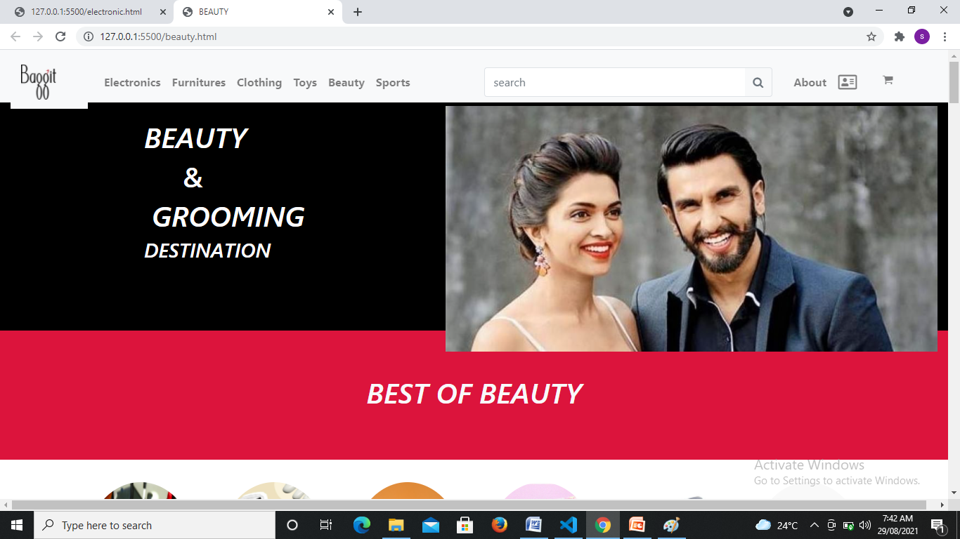

Slide 23
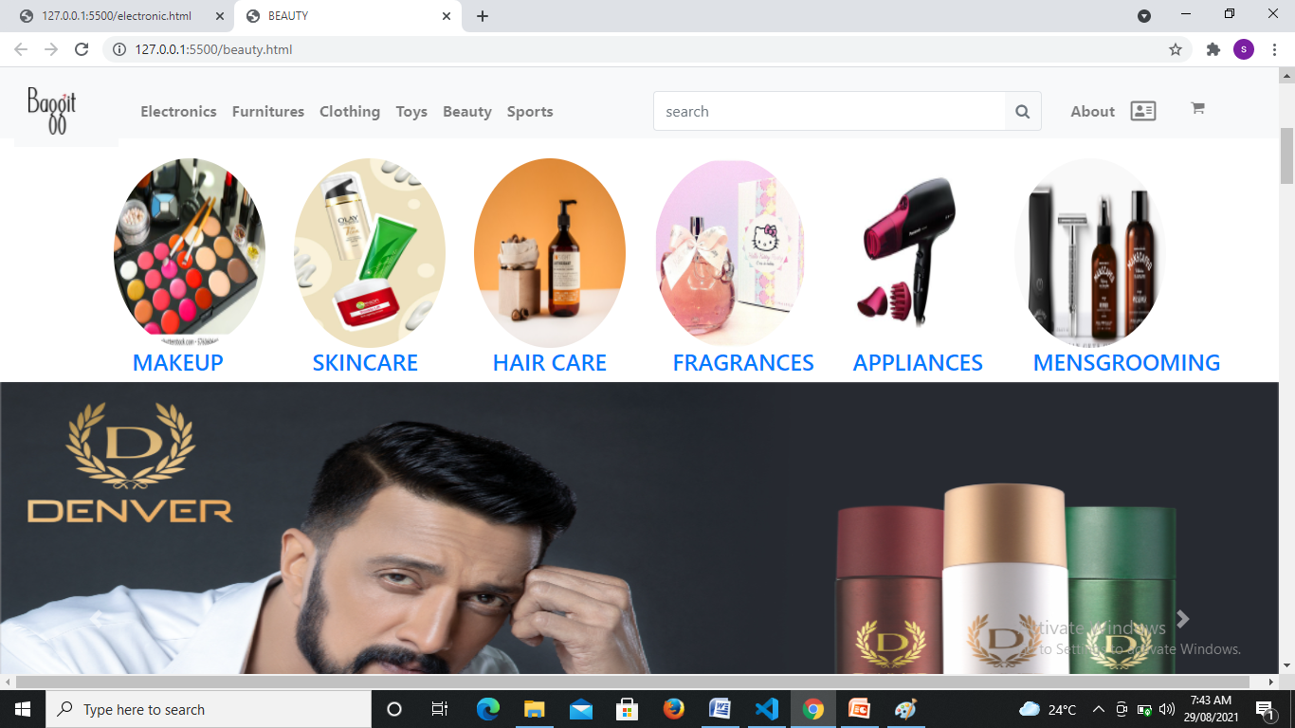

Slide 24
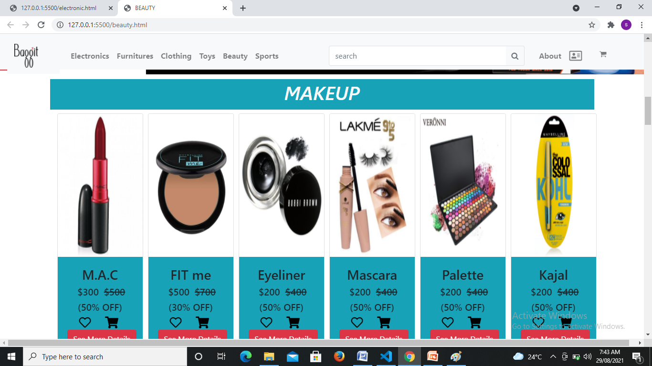

Slide 25
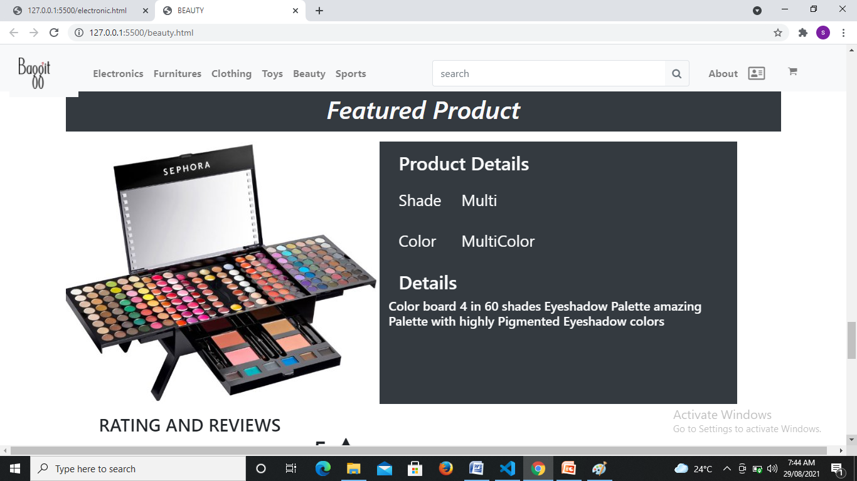

Slide 26
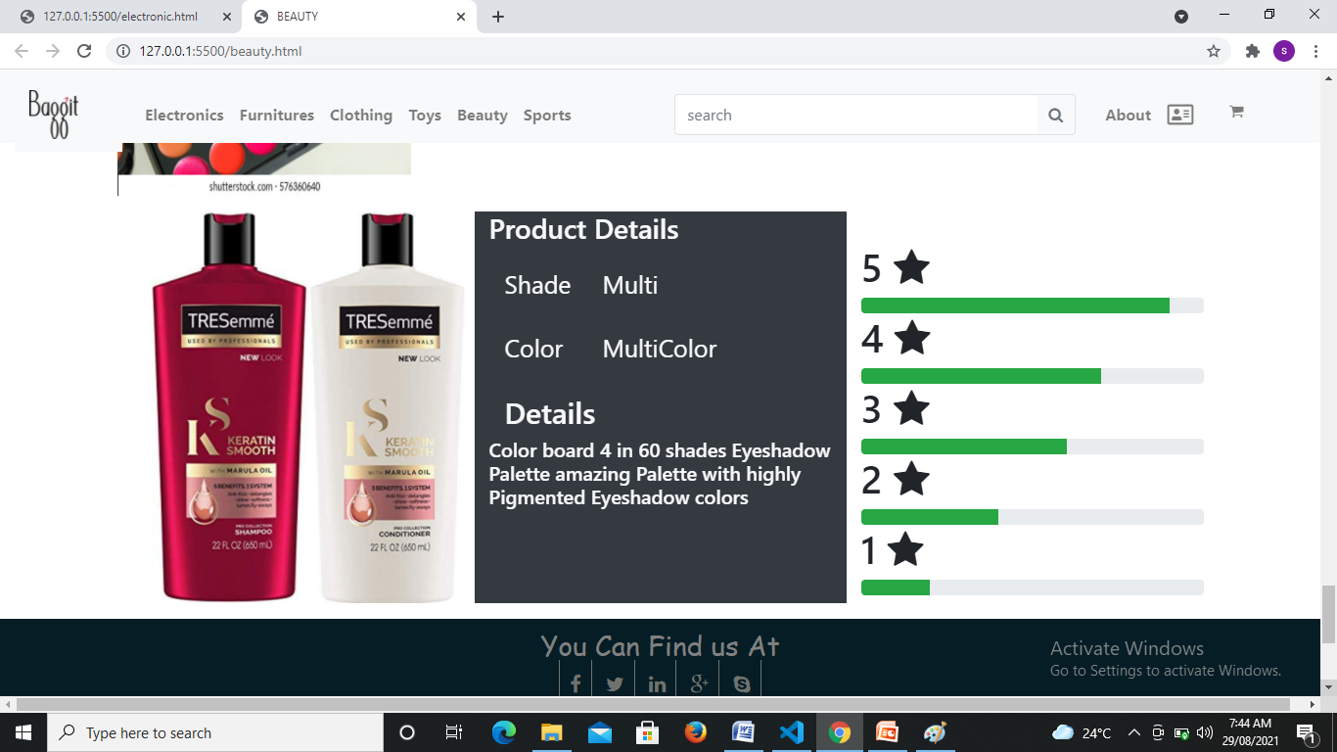

Slide 27
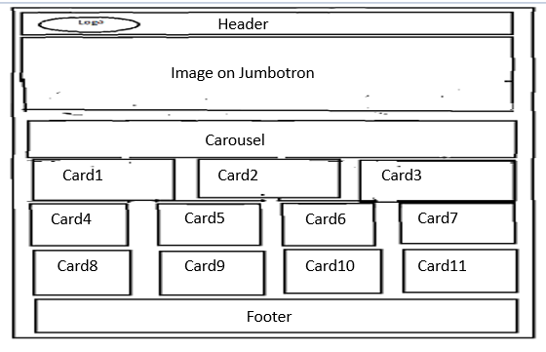
Furniture
Wire frame design :-

Slide 28


Jumbotron with image and text :-
Carousel with 3-Images :-

Slide 29


Carousel with 3-Images :-

Slide 30
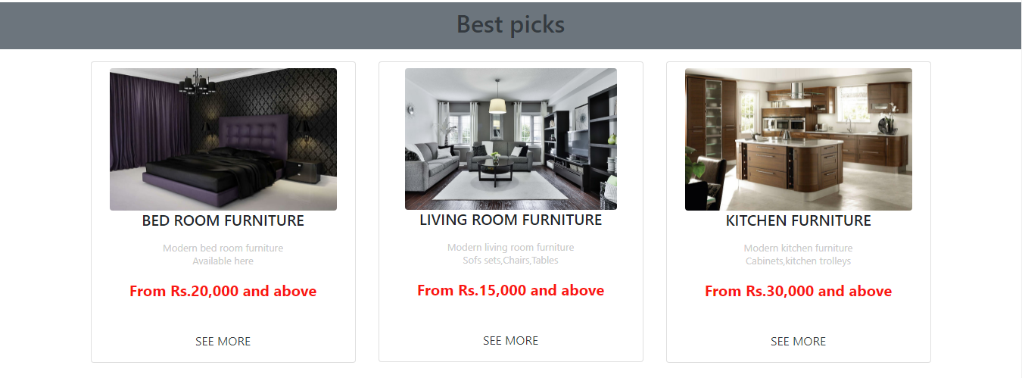
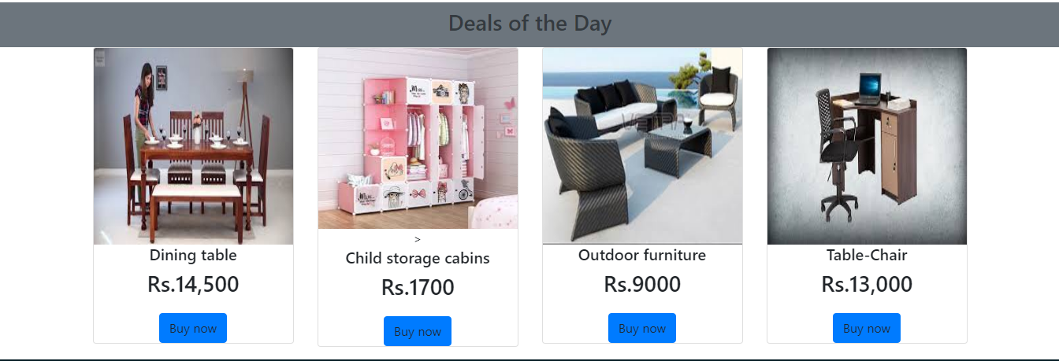
Products with cards :-

Slide 31
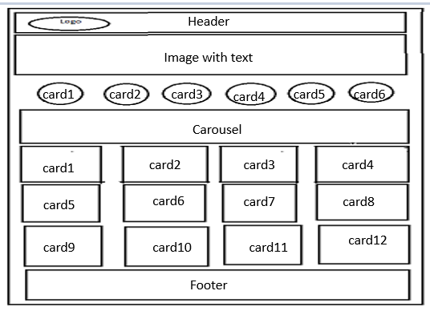
SPORTS
Wire Frame design :-

Slide 32


Image with text :-
Circular cards for products :-

Slide 33
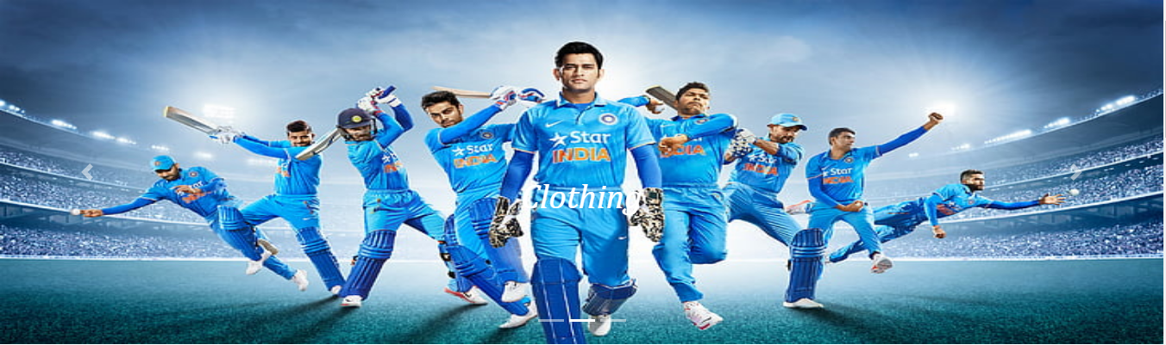
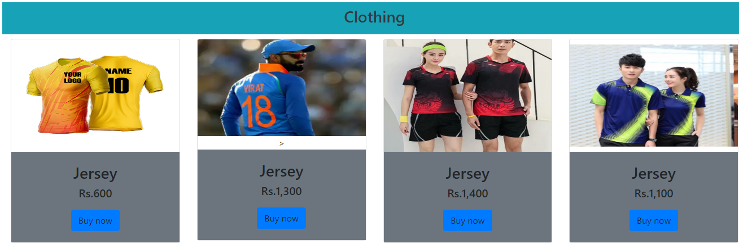
Carousel with 3-Images :-
Cards for Products :-

Slide 34
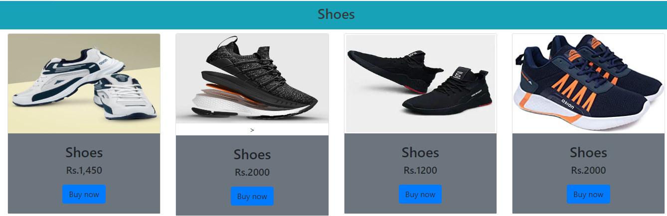
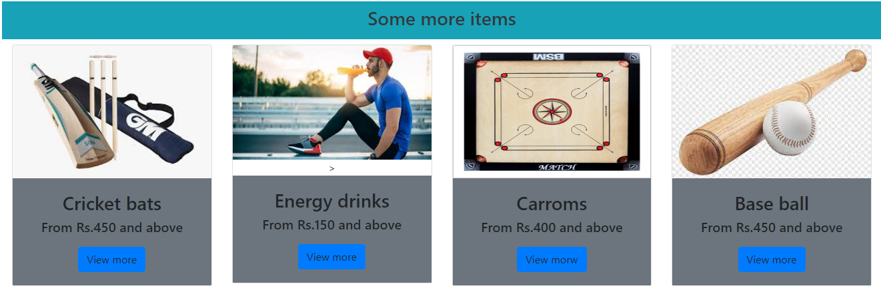
Cards for Products :-

Slide 35
i

Slide 36
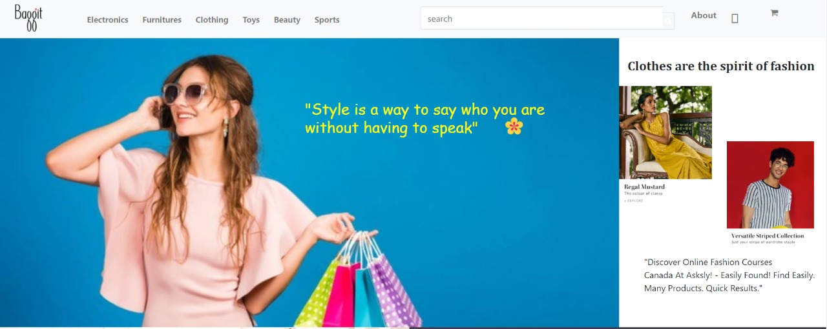
CLOTHING PAGE

Slide 37
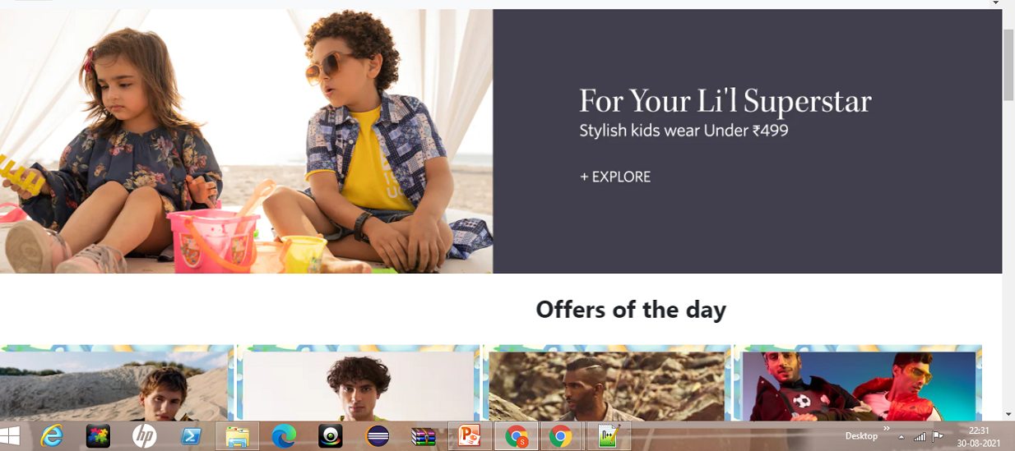
Trending Clothes section

Slide 38

Offers Section

Slide 39
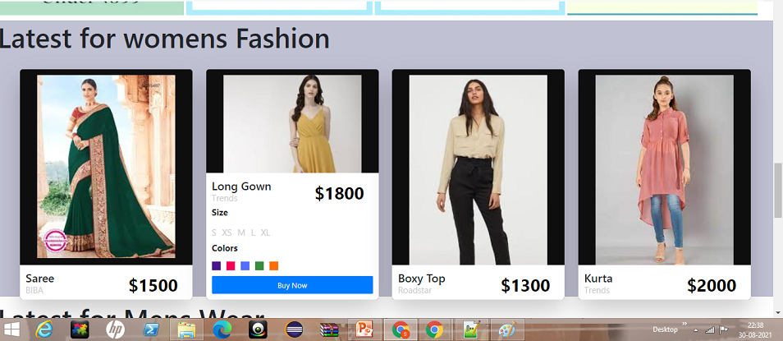
Clothes Description

Slide 41
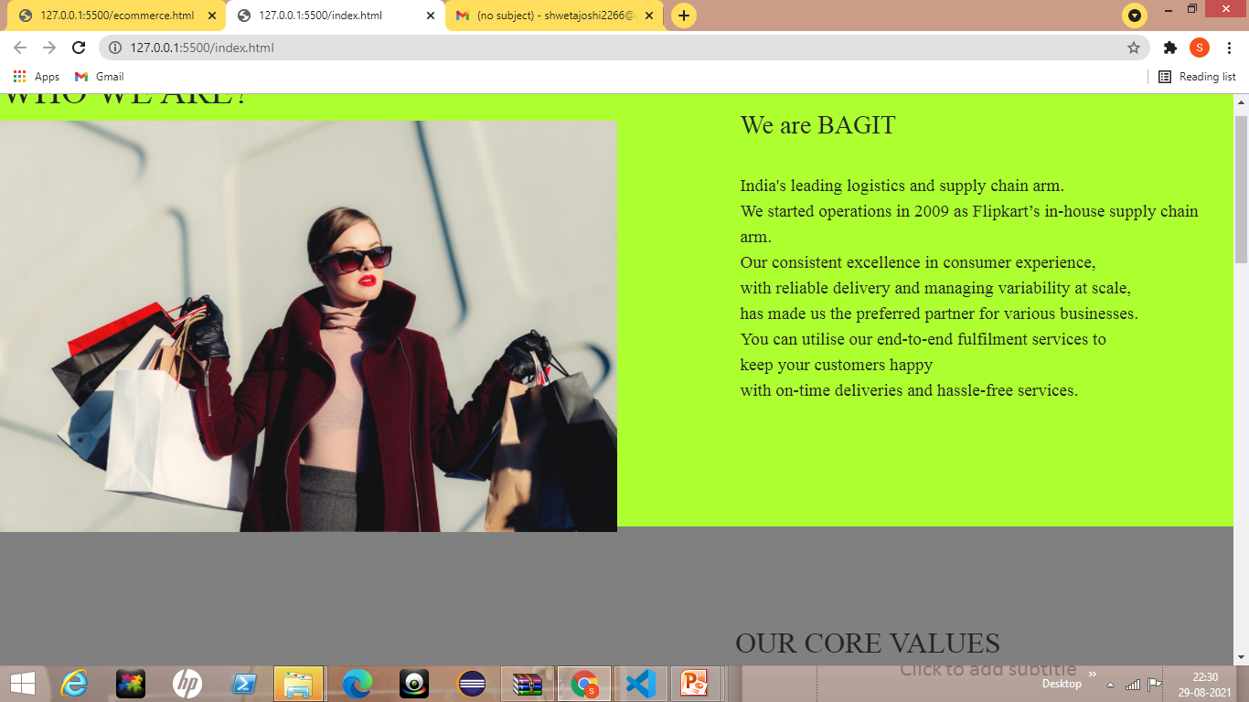

Slide 42
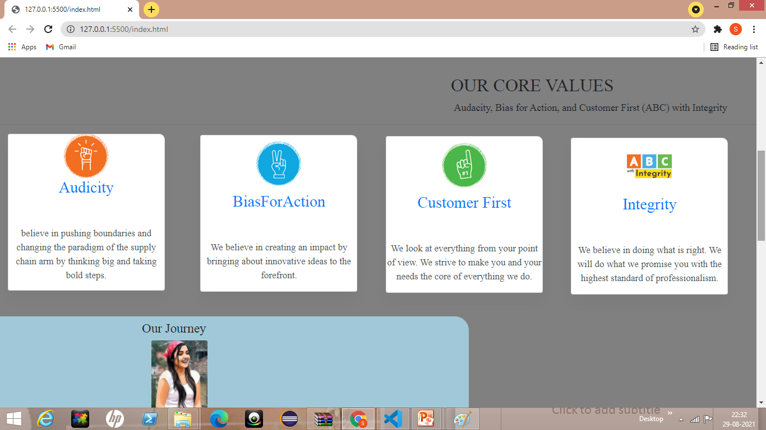

Slide 43
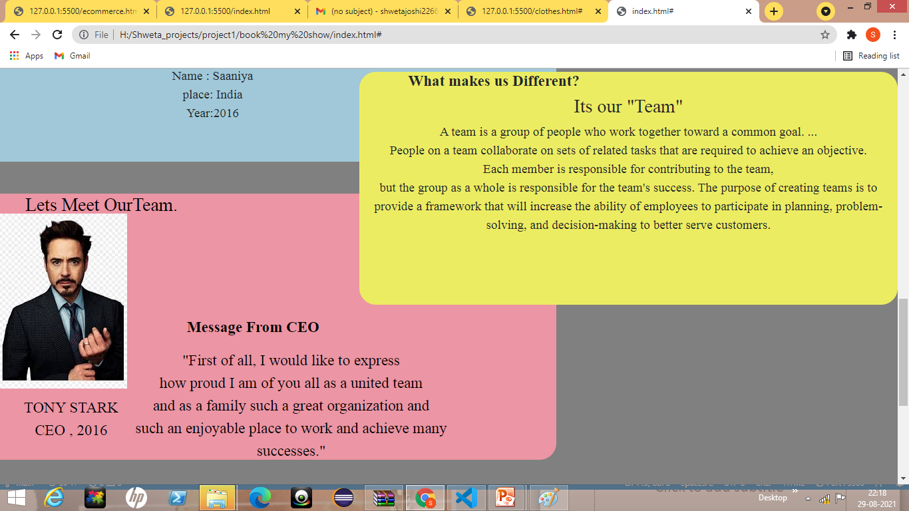

Slide 44
